Slide 1
TO Each His Own: Personalized Content Selection Based on Text Comprehensibility
Date: 2013/01/24
Author: Chenhao Tan, Evgeniy Gabrilovich, Bo Pang
Source: WSDM ’12
Advisor: Dr. Jia-Ling Koh
Speaker: Yi-Hsuan Yeh

Slide 2
Outline
Introduction
Methodology
Estimating text comprehensibility
Generating pairwise preferences
Modeling user comprehensibility preferences
Combining the ranking
Experiments
Web search
CQA
Conclusion

Slide 3
Introduction
Search engines mostly adopt the one-size-fits-all solution.
A famous physician might also be a beginner cook, and would therefore prefer easy-to-understand cooking instructions.
The text comprehensibility level should match the user’s level of preparedness.
Goal：
Use text comprehensibility as well as user’s preference to predict future content choices and to rank results.

Slide 4
Introduction
Rank texts by comprehensibility.
Modeling user comprehensibility preferences
Personalized ranking.

Slide 5
Outline
Introduction
Methodology
Estimating text comprehensibility
Generating pairwise preferences
Modeling user comprehensibility preferences
Combining the ranking
Experiments
Web search
CQA
Conclusion

Slide 6
Estimating text comprehensibility
Comprehensibility classifier
Output : the likelihood of the article being hard to read (comprehensibility score, Sc ) (0-1)
Training data：
Simple English Wikipedia → easy
English Wikipedia → hard
Feature
Basic English 850 word (TF, L2-normalize)

Slide 7
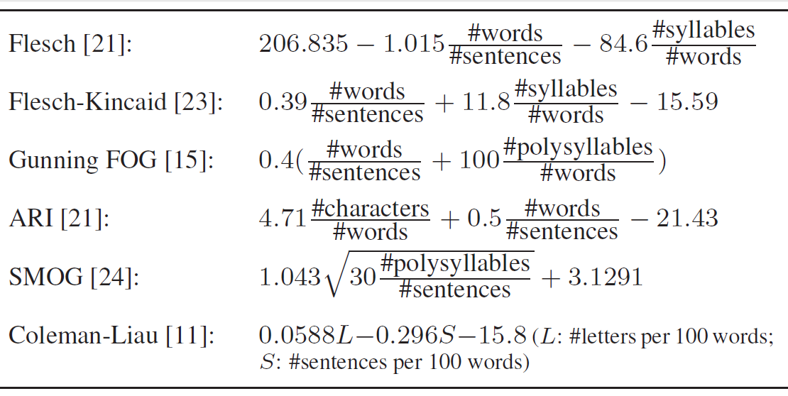
Global threshold = 0.5

Slide 8
It is more meaningful to use Sc for comparing document within the same topic.

Slide 9
Generating pairwise preferences
Web search click log
CSA (Click > Skip)
LCSA (Last click > Skip above)
LCAA (Last click > All above)
Query： toy
Result：l₁, l₂ , l₃, l₄, l₅
Click： l₂ , l₄
Best answers in CQA forums
best answers > all the other
Notes:
作者使用3種方法來取得pairwise

Slide 10
Preference weighting
Web search
ex : l₄ >u l₁ , w = 0.25
CAQ
w = 1/n (There are n answers for a question)

Slide 11
Modeling user comprehensibility preferences
Topical-independent profile (BASIC)
n：number of preference pairs for each user

Slide 12
Weighted version

Slide 13
Topic-dependent profile (TOPIC)
default
root
t1
t2
….
t17
… …. …. .…
t11 t12 t1n t17m
Many users might have only read a few texts in each topic, or none at all in some topics
→ lack of topic-specific preference pairs

Slide 14
Collaborative filtering (COLLABORATIVE)
Analyze the observed comprehensibility preferences over all pairs, and predict comprehensibility preferences for unseen ones
nu：the number of users
nt：the number of topic
Gij：the likelihood of user i preferring harder content in topic j (Pu)
G =
nu x nt
Maximum-margin matrix factorization：G → U^{T}V
Minimize
CofiRank

Slide 15
Combining the ranking
R(d)：the rank of document order by topic-relevance-based
Ru(d)：the rank of document order by the comprehensibility score (Sc)
β = 0.4

Slide 16
Outline
Introduction
Methodology
Estimating text comprehensibility
Generating pairwise preferences
Modeling user comprehensibility preferences
Combining the ranking
Experiments
Web search
CQA
Conclusion

Slide 17
Search dataset
Yahoo! Web Search query logs
2011, May
Filter out navigational queries
Top 10 results for queries
Snippets → higher Sc
Domain-averaged Sc as the smoothed Sc for each page
Pages → classified into 17 top-level nodes
154,650,334 pages
424,566 users

Slide 18
Evaluation measures
Average Click Rank
Lower average clicked rank values indicate better performance
s：query
Cs：the set of clicked Web pages for query s
R(p)：the rank of page p
S : query set

Slide 19
Rank Scoring
Larger rank scoring value indicates better performance
1 → if page j is clicked for the query s
0 → otherwise
All clicked page appear at the top of ranked list
j：the rank of a page in the list
α：half-life, the number of the page on the list such that there is a 50-55 chance the user will review that page. (α = 5)

Slide 20
User Saliency

Slide 21
Experiments on search data
LCAA + weight + collaborative

Slide 22
Overall analysis over non-repeated queries

Slide 23
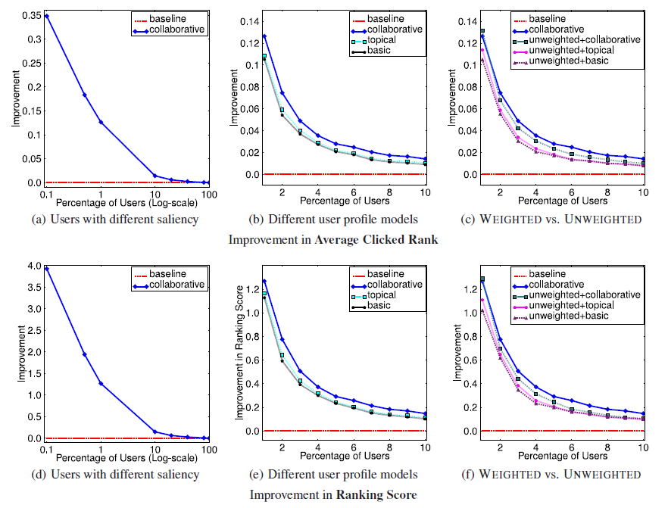
LCAA + weight

Slide 24
Improvement by topic

Slide 25
The variance in Sc for search result of a query.

Slide 26
Percentage of users with Pu > 0.5

Slide 27
Answer dataset
Yahoo! Answers
2010, January – 2011, April
Best answer was chosen by asker
4.9 million questions, 39.5 million answers
85,172 users

Slide 28
Experiments on answers
Random baseline：answers were ranked in random order
Majority baseline：rank answers in decreasing Sc
Lower values indicate better performance.

Slide 29
Outline
Introduction
Methodology
Estimating text comprehensibility
Generating pairwise preferences
Modeling user comprehensibility preferences
Combining the ranking
Experiments
Web search
CQA
Conclusion

Slide 30
Conclusion
Modeling text comprehensibility can significantly improve content ranking, in both Web search and a CQA forum.
A comprehensibility classifier.
Modeling user comprehensibility preferences.
In future work, develop more sophisticated comprehensibility classifiers, and use demographic information (gender, age).

